Slide 1

INDIAN CROP YIELD PRODUCTION ANALYSIS
PRESENTED BY
BISWAJIT MAITY
DATA ANALYST
LEARNBAY INSTITUTE OF PVT. LTD.

Slide 2
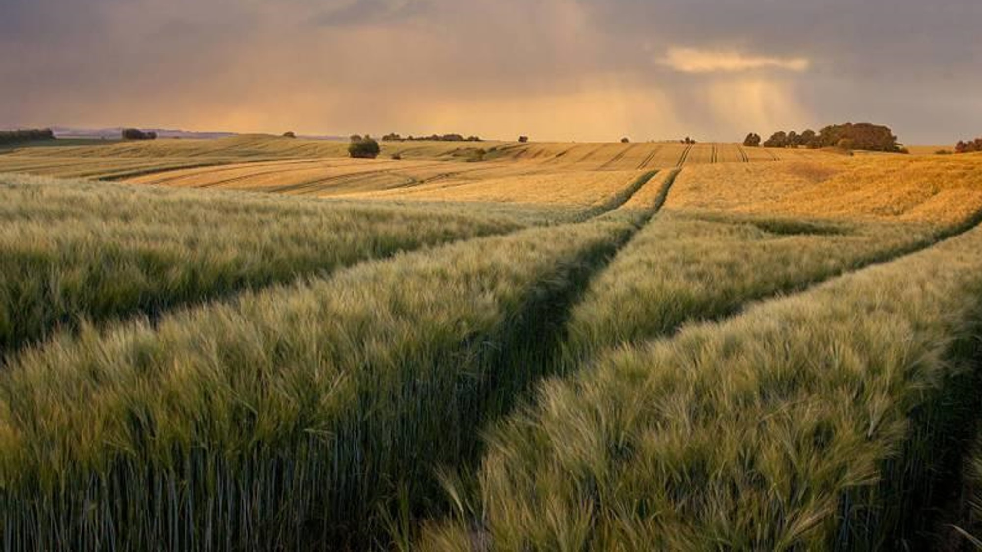
INTRODUCTION The dataset focuses on agricultural crop production across various states and districts in India over multiple years. It includes detailed information such as crop type, the area cultivated, the quantity produced, and the season in which the crops were grown. This data provides valuable insights into regional agricultural performance, including production trends and the efficiency of land use (yield). Additionally, the dataset allows for year-over-year analysis, helping to track changes in crop production and identify which crops or regions are the most efficient and productive. Overall, it serves as a robust resource for exploring the dynamics of crop production and supporting agricultural decision-making.

Slide 3

AGENDA
Which states have the highest crop production?
What are the top crops in each region, and how does crop production vary by season?
How has crop production evolved over the years for key crops?
Which crops have the highest yields, and how do yields differ across regions?
How does production vary seasonally across the years?

Slide 4



TOOLS USED
Power bi

Slide 5
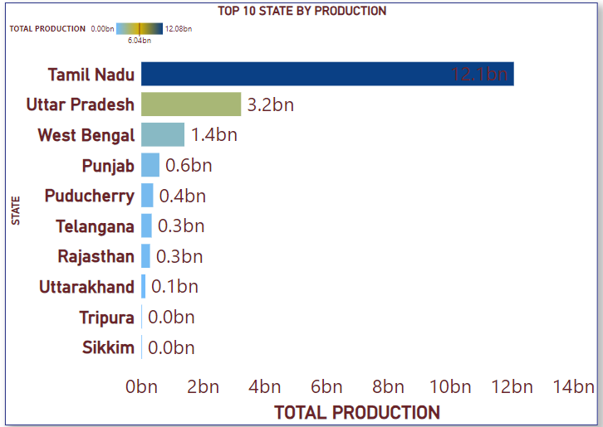
Which states have the highest crop production?
According to the chart, Tamil Nadu has the highest crop production, reaching 12.1 billion units, significantly surpassing other states. Uttar Pradesh follows in second place with 3.2 billion, while West Bengal ranks third with 1.4 billion units of production. The remaining states, including Punjab, Puducherry, Telangana, and others, exhibit much lower production levels, with figures below 1 billion. The graph highlights the dominance of Tamil Nadu in crop production compared to the other states.

Slide 6
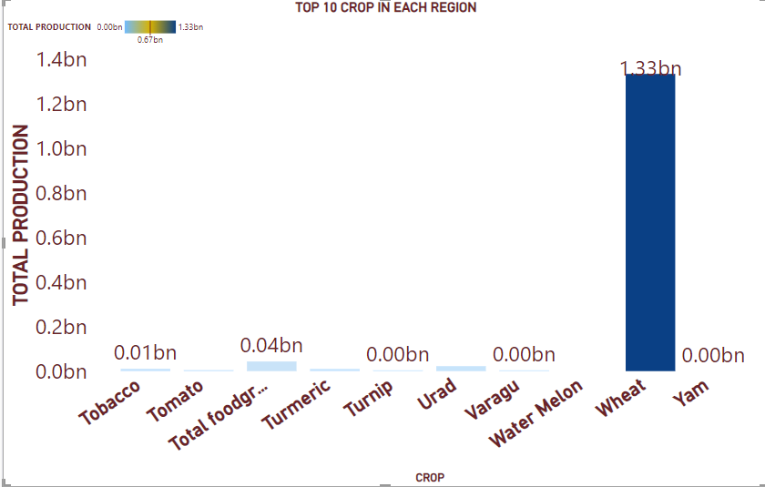
What are the top crops in each region?
The graph displays the Top 10 Crops in Each Region based on total production. Wheat is clearly the highest-producing crop, with a total production of 1.33 billion units, far surpassing all other crops. Other crops, such as Turmeric (0.04 billion), Tobacco (0.01 billion), and Tomato, have significantly lower production levels. Several crops, including Turnip, Urad, Varagu, Watermelon, and Yam, show negligible or zero production. This indicates that wheat dominates production across regions compared to other crops.

Slide 7
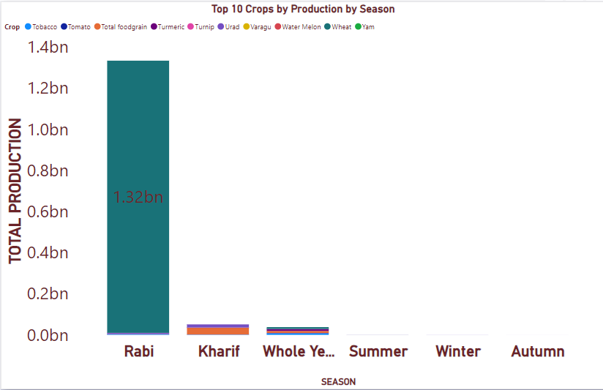
What are the top crops in each region?
The graph shows a significant variation in crop production across different seasons, with the Rabi season having the highest production, totaling 1.32 billion units. Other seasons such as Kharif, Whole Year, Summer, Winter, and Autumn show minimal production levels in comparison, indicating that most crop production is concentrated in the Rabi season.

Slide 8
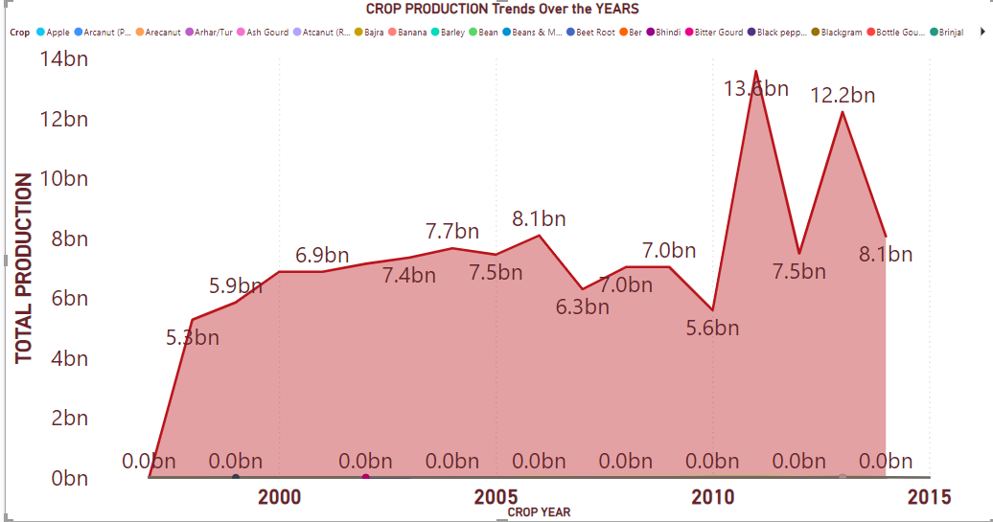
How has the crop production evolved over the years for key crops?
The graph shows a fluctuating trend in crop production over the years. From 2000 to 2010, crop production steadily increased, peaking at 13.6 billion units in 2010, followed by a sharp decline. After 2010, production experienced significant volatility, dropping to 5.6 billion in 2012 before recovering to 12.2 billion in 2013, and then leveling out to around 8.1 billion by 2015. This indicates periods of both strong growth and sharp declines in crop production.

Slide 9
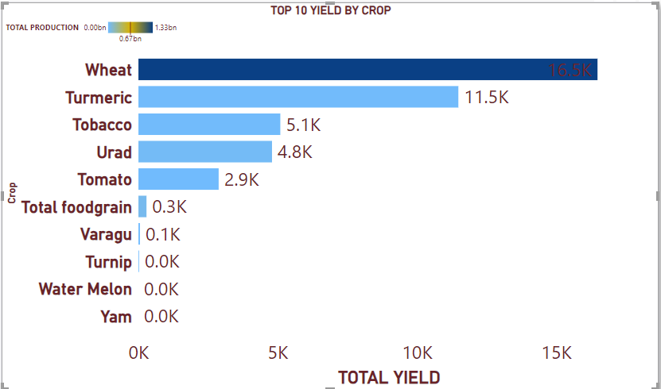
Which crops have the highest yields?
The graph Top 10 yield by crop shows the wheat production is very high .

Slide 10
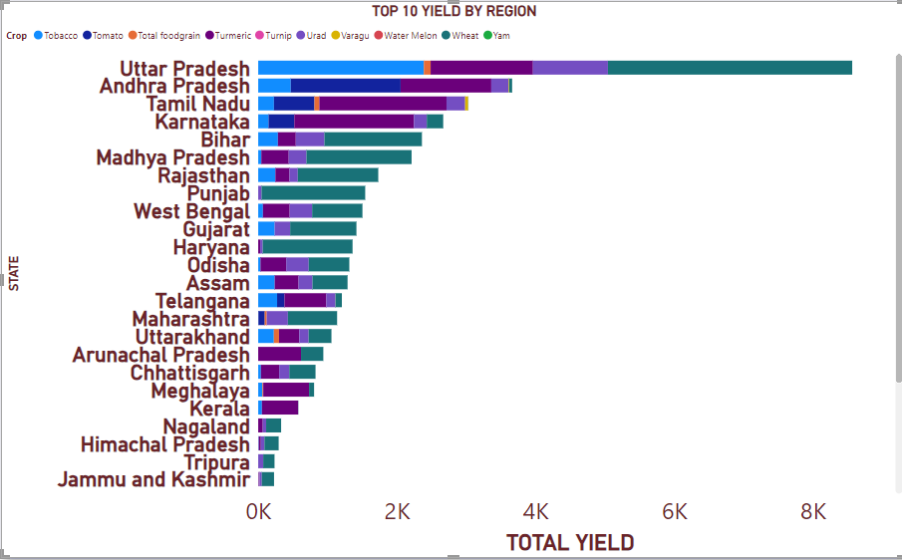
How does yields differ across region?
The graph Top 10 yield by region shows the uttar Pradesh is very high .

Slide 11
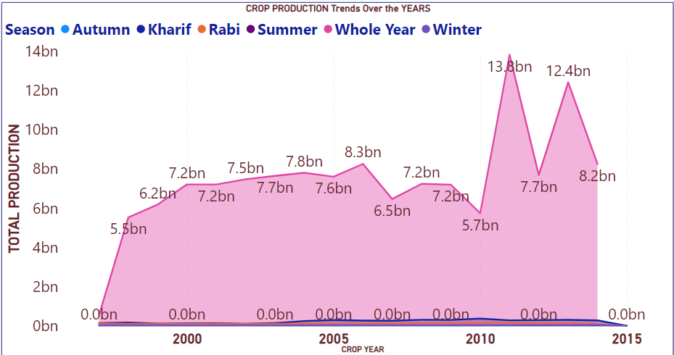
How does production vary seasonally across the year ?
From the visualization, we observe the following trends.
The “whole year” season has consistently higher crop production compared to other seasons.
There is a noticeable peak around 2010-2012, indicating a surge in production during this period followed by decline.

Slide 12

Wel come to my visual

Slide 13
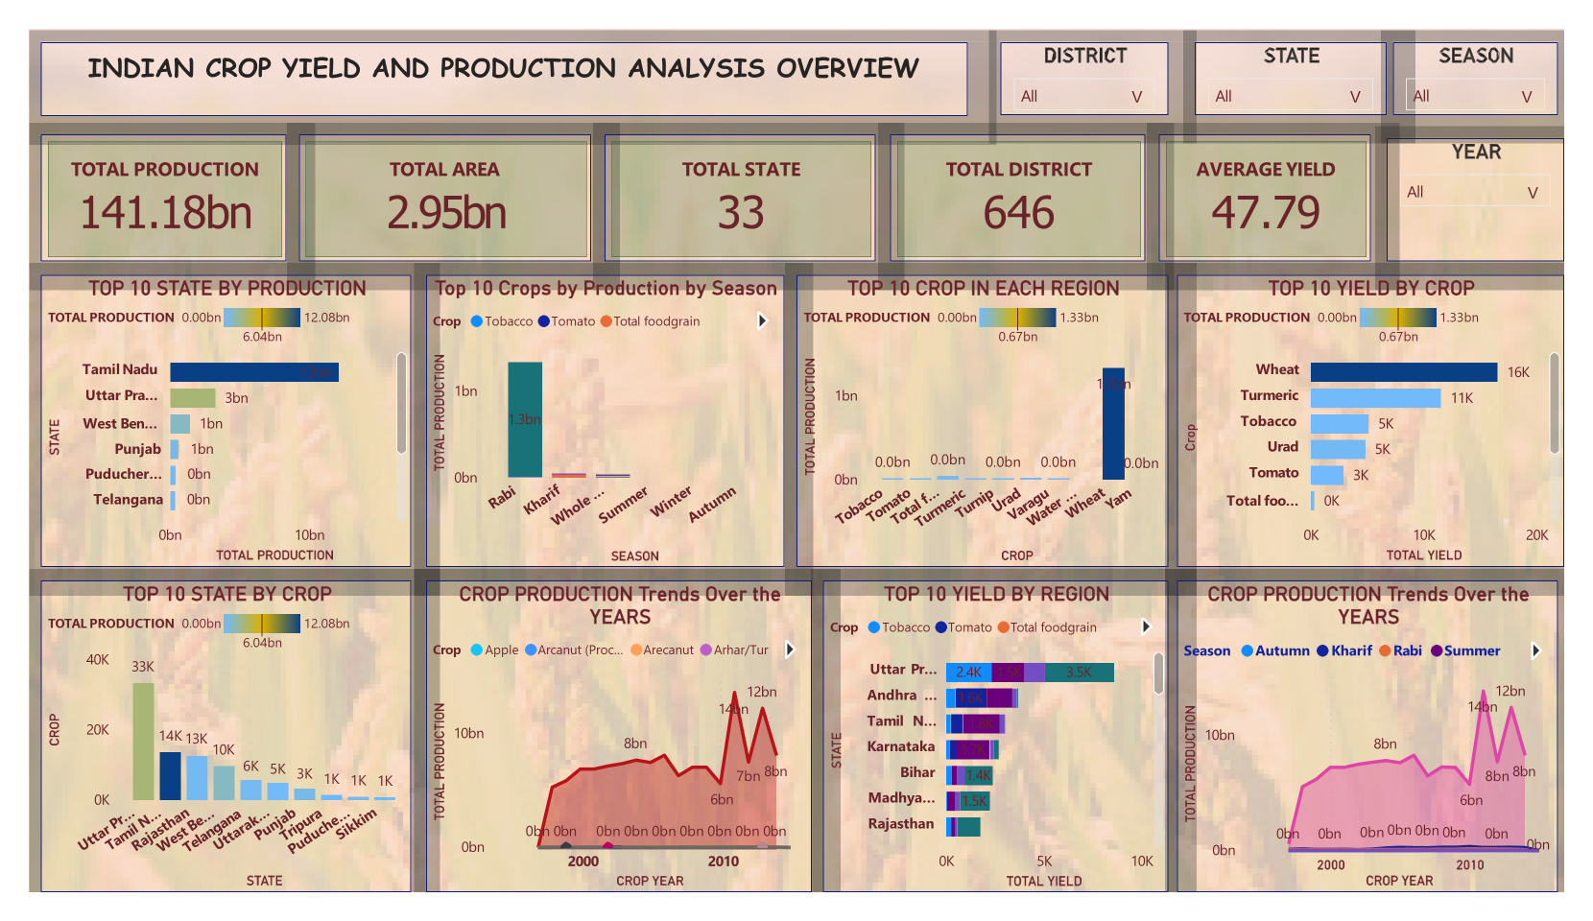

Slide 14

Thank you
BISWAJIT MAITY
8167635058/890223874
biswajjitmaity19981@gmail.com​
www.linkedin.com/in/biswajitmaity1315

